Slide 1
A Brief Overview of Git
William Evangelista Department of Chemical and Biological Engineering
Advisor: Dr. Johannes Hachmann
CSC club presentation
03 December 2015

Slide 2
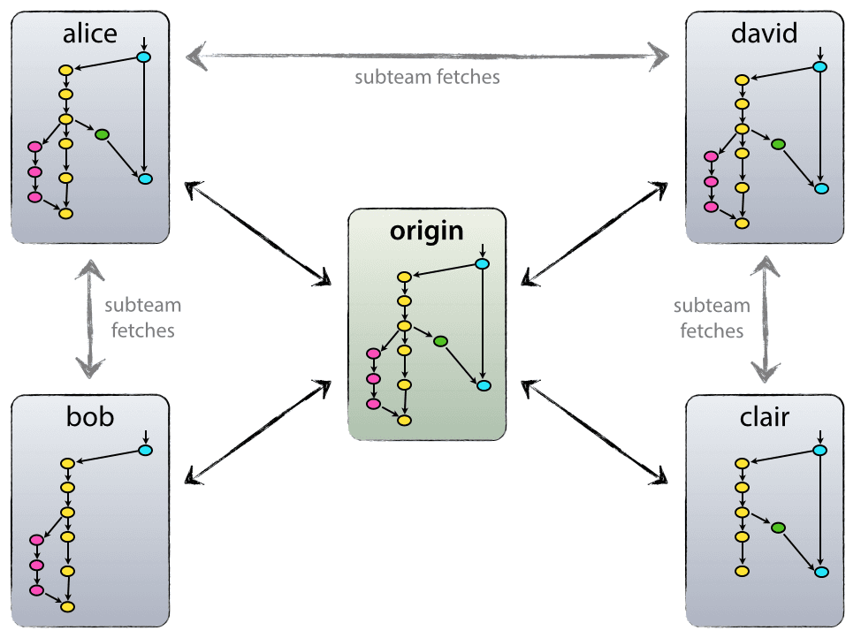
Getting started
First need to initialize a repository on your machine
mkdir “repo”
git init
Next set up some standard configuration settings
git config --global user.name “Your Name“
git config --global user.email user@buffalo.edu
git config --list
Next you need to add your remote repo
git remote add origin “URL”
git push origin master
Notes:
The name for the “central” repository is generally taken to be origin though you can name it whatever you want.
This way if you link to other developers as well you can keep track of your “central” repo and developer remotes separately

Slide 3
Add, remove, status and .gitignore
To add new files so that git will track them
git add “filename”
You can list a single filename, a directory or something like *.txt
To remove a file from tracking
git rm “filename”
To get the current state of you repo
git status
This shows all files that are different than the current commit and their current status eg. tracked, untracked
The .gitignore file
The .gitignore file can be used so that git will ignore specific files or filetypes
It can be useful so that git will stop reminding you that your not tracking that one logfile every time you run git status

Slide 4
Commits
After you make changes you will want to commit your changes to keep track of them
git commit –a –m “comment”
The –a option allows you to add all files that you’ve made changes on
The –m option lets you make an inline comment instead of opening a text editor for you
Your changes are now saved, but only on your local machine
If you make a mistake or need to add something small
git commit –amend –m “fixed”
The amend flag allows you to replace the previous commit with a new one, combines any new staged changes with the previous ones
Notes:
As an aside the –a flag is equivalent to git add filename which stages your changes
Also git status is a useful command to look at currently staged files

Slide 5
Push/(Pull/fetch)
Now that changes have been made you will want to either push your changes or pull someone else’s
git push origin master
The “origin” part of the command is just the name of your remote
In this case “master” means that you are pushing to the master branch
The (pull/fetch) command works in exactly the same way
git pull origin master
Fetch gets commits not in your local branch, but does not merge them with your current work
Pull on the other hand actually performs git fetch followed by git merge in one step

Slide 6
Branches
To create a new branch there are several options
git branch “branchname”
git checkout –b “branchname”
To push your new branch up to bitbucket
git push origin “branchname”
Branches are useful for making your own changes before you merge changes back into the master branch
Notes:
Aside git checkout can be used to move between branches or to briefly checkout old commits

Slide 7
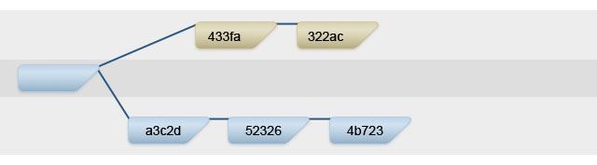
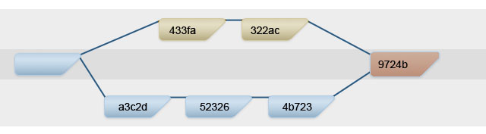
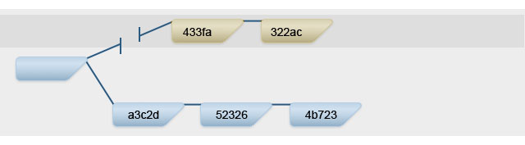
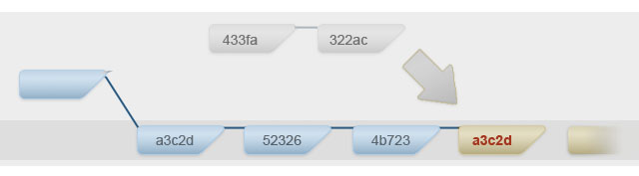
Rebase/merge
Merge
git merge [branch]
This merges [branch] into the current branch
Rebase
git rebase [base]
This rebases the current branch on top of the [base] branch
Notes:
Rebase allows you to keep your development history clean and linear, need to be careful though as you should usually only rebase local changes, so that you don’t rebase changes that someone else is building off of.

Slide 8
How to undo something
There are several options depending on your circumstances
If you’ve pushed changes by mistake
git revert <sha>
In this case <sha> is for the accidental commit
Basically makes a reverse commit for you to push
If you want to undo local commits
git reset <sha> or git reset --hard <sha>
In this case <sha> is your last good commit
The --hard flag resets your working directory to the selected <sha> whereas without it only the commit is reset
Notes:
[sha] = secure hash algorithm
This is all from
https://github.com/blog/2019-how-to-undo-almost-anything-with-git
And a little from
https://www.atlassian.com/git/tutorials/rewriting-history/

Slide 9
How to undo something
Ok you’ve just done a hard reset and realized that you really want some of those changes back
git reflog
This will bring up the reflog which shows all the times HEAD has changed
From here you can select which commit to go back to even one that you reset away from
git reset --hard <sha>
git checkout <sha> -- <filename>
git cherry-pick <sha>
Notes:
HEAD essentially just points to the current branch, so the reflog keeps track of any time the current branch is changed
Your reflog doesn’t last forever

Slide 10
Resources
Git commands
https://www.siteground.com/tutorials/git/commands.htm
Undoing stuff
https://github.com/blog/2019-how-to-undo-almost-anything-with-git
https://www.atlassian.com/git/tutorials/rewriting-history/
Merge/rebase
http://blog.experimentalworks.net/2009/03/merge-vs-rebase-a-deep-dive-into-the-mysteries-of-revision-control/

Slide 11
Setting up on CCR
First want to clone in our repository
git clone “URL”
Or
mkdir [dirname]
cd [dirname]
git init
git remote add origin “URL”
git pull origin master

Slide 12
Setting up on CCR
You may also want to set up a mergetool for use on the cluster
To use vimdiff as a mergetool
git config --global merge.tool vimdiff
git config --global merge.conflictstyle diff3
git config --global mergetool.prompt false

Slide 13
You forgot to set your branch to track the remote
If you are currently on that branch
git branch -u origin/branchname
If you are on another branch
git branch -u origin/branchname branchname

